Slide 1

Projects Using React.js & Flux
Project 10: WorkoutLogger

Slide 2
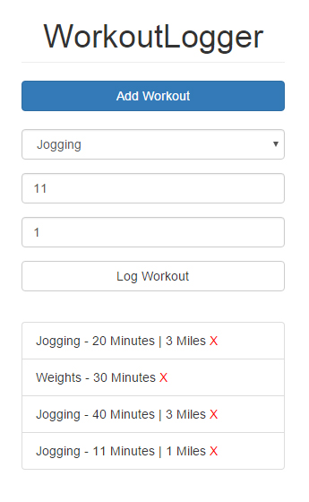
Project Description
Workout log app with a mobile-friendly interface. Uses localStorage API

Slide 3
Project Lectures
Section Intro
Setup & ShowForm State
AddWorkout Component
Using LocalStorage
Fetch & Display Workouts
Deleting Workouts

Slide 4
What You Will Learn
How to create a simple mobile friendly Bootstrap template
How to persist data to localStorage
How to fetch data and use the localStorage API

